Slide 1
ANT

Slide 2
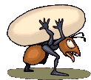

Slide 3
DOG

Slide 5
CAT

Slide 7
Cow

Slide 9
horse

Slide 10
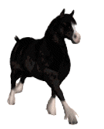

Slide 11
CATS

Slide 12
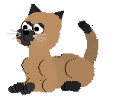

Slide 13
sheep

Slide 14
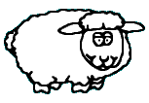

Slide 15
goat

Slide 16
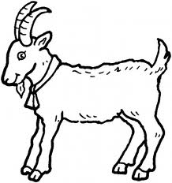

Slide 17
mouse

Slide 18
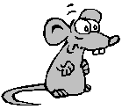

Slide 19
The cow is green

Slide 20
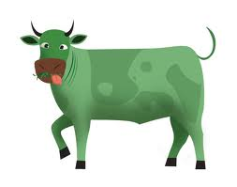

Slide 21
mat

Slide 22
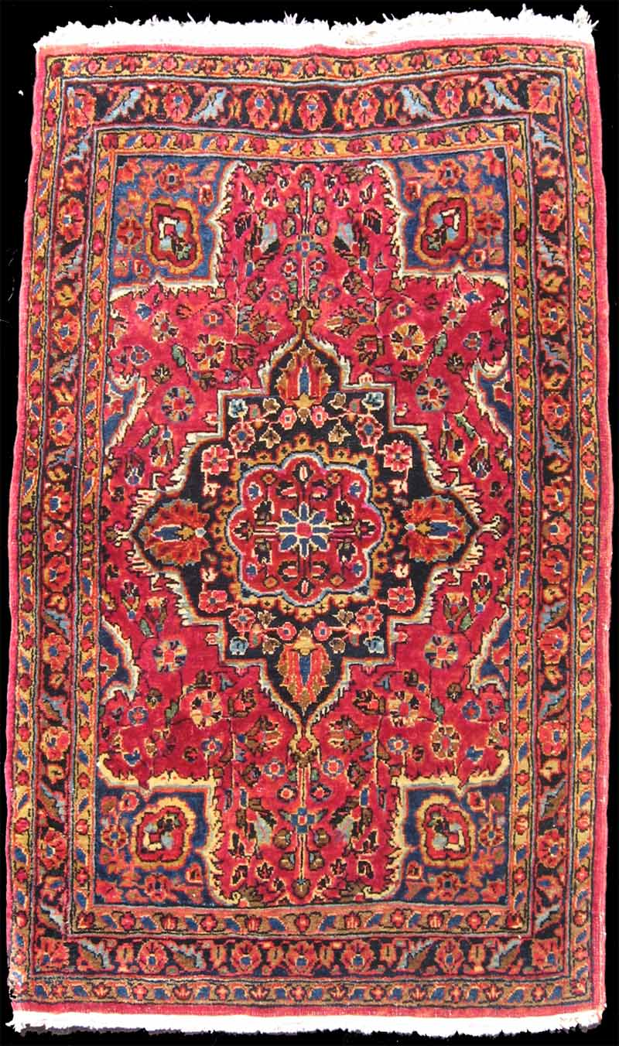

Slide 23
bat

Slide 24
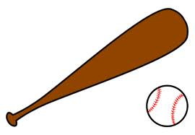

Slide 25
bat

Slide 26
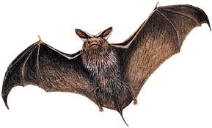
bat

Slide 27
net

Slide 29
cap

Slide 30
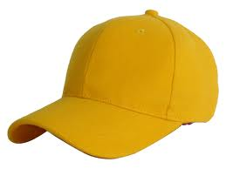

Slide 31
can

Slide 32
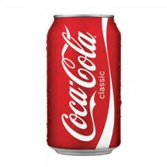

Slide 33
A cap on a man

Slide 34
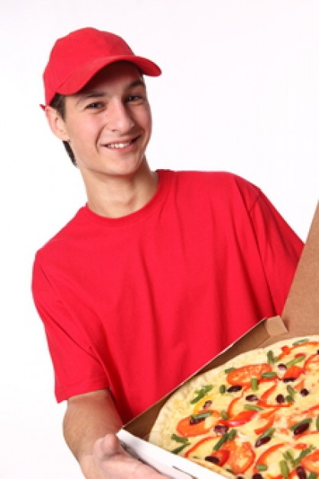

Slide 35
A cat on a mat

Slide 36
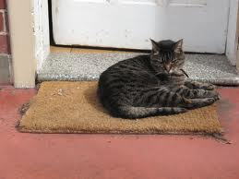
A cat on a mat

Slide 37
A bat and a net

Slide 38
A bat and a net

Slide 39
A can in a bag

Slide 40
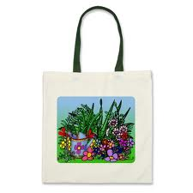
A can in a bag

Slide 41
I have a dog

Slide 42
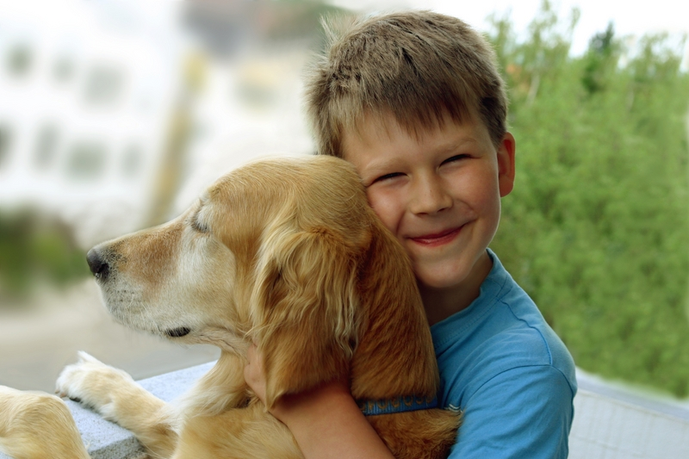
I have a dog

Slide 43
SNAKE

Slide 44
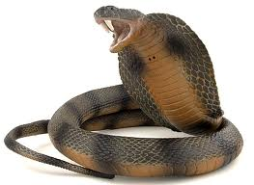

Slide 45
elephant

Slide 46
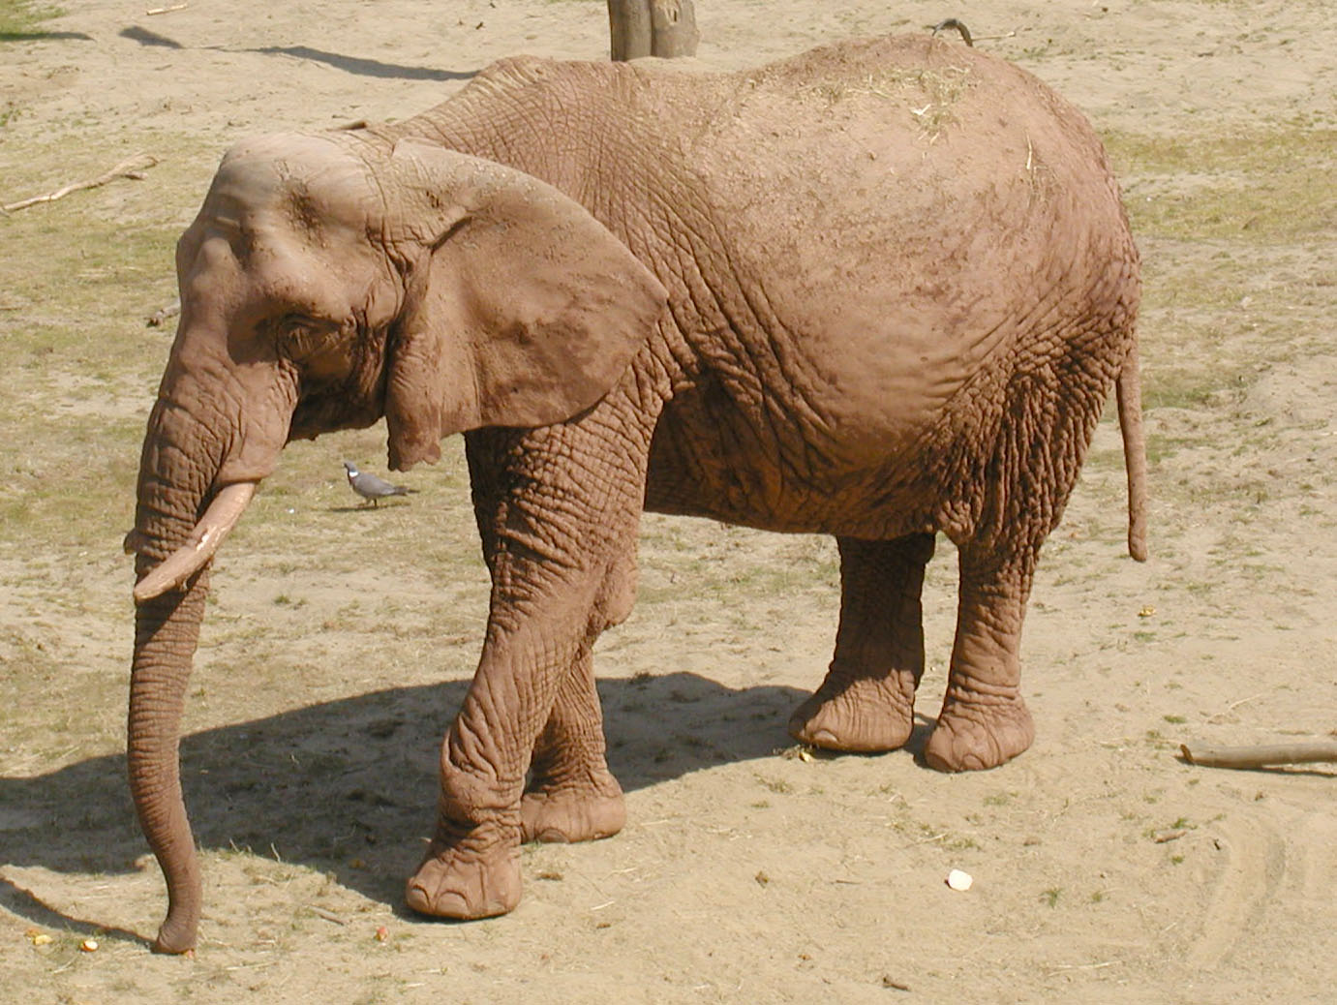

Slide 47
hen

Slide 48
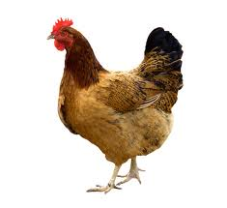

Slide 49
monkey

Slide 50
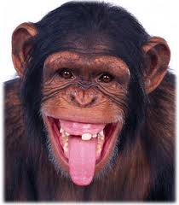

Slide 51
panda

Slide 52
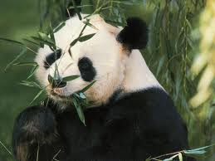

Slide 53
giraffe

Slide 54
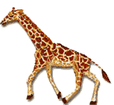
giraffe

Slide 55
gorilla

Slide 56
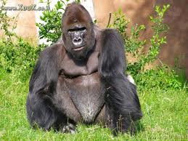

Slide 57
bear

Slide 58
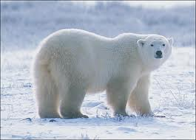

Slide 59
hat

Slide 60
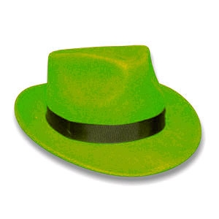

Slide 61
look

Slide 62
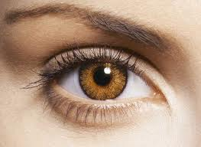

Slide 63
egg

Slide 64
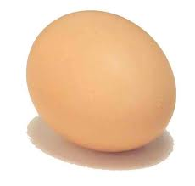

Slide 65
pen

Slide 66
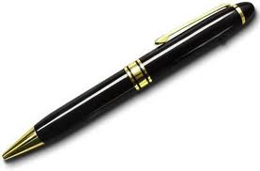

Slide 67
Tom has a cat

Slide 68
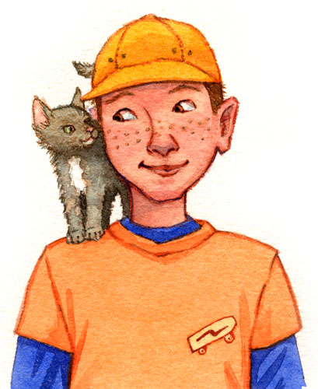

Slide 69
Tom’s cat is not big

Slide 71
Dad is sad

Slide 73
I like dogs

Slide 74
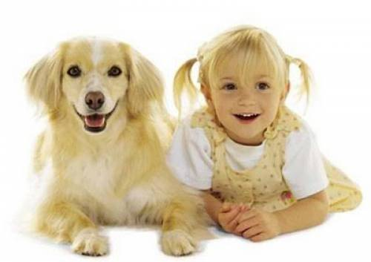

Slide 75
zoo

Slide 76
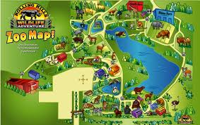

Slide 77
see

Slide 78
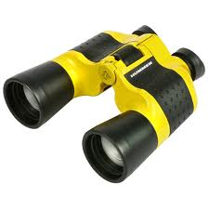

Slide 79
I can see

Slide 81
fat

Slide 82
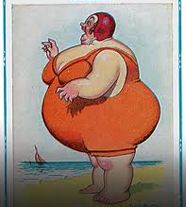

Slide 83
man

Slide 85
pig

Slide 86
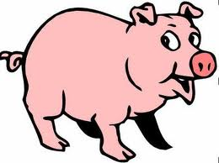

Slide 87
iguana

Slide 88
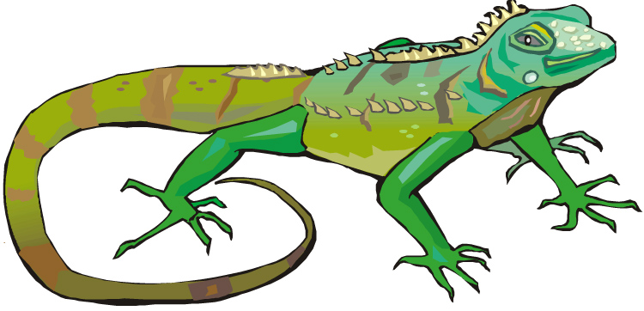
iguana

Slide 89
tall

Slide 90
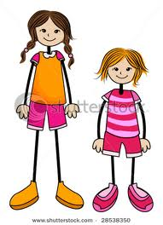
tall

Slide 91
thin

Slide 92
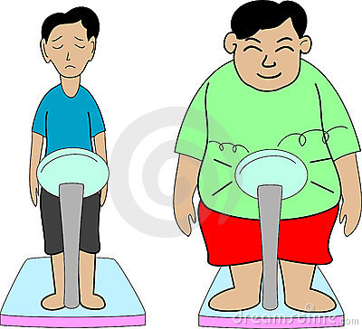
thin

Slide 93
long

Slide 94
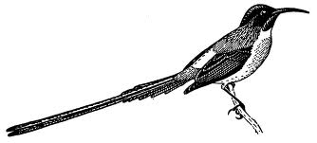
long

Slide 95
short

Slide 96
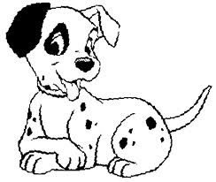
short

Slide 97
big

Slide 98
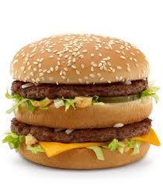
big

Slide 99
sand

Slide 100
sand

Slide 101
bed

Slide 102
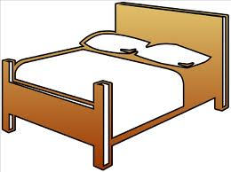
bed

Slide 103
Sid is a man

Slide 104
Sid is a man

Slide 105
tail

Slide 106
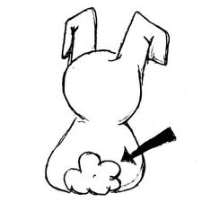
tail

Slide 107
sad

Slide 108
sad

Slide 109
Din is not in bed

Slide 110
Din is not in bed

Slide 111
A cat is in a bed

Slide 112
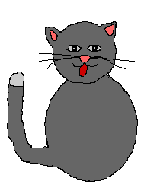
A cat is in a bed

Slide 113
A cat and a dog are on the sand

Slide 114
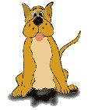
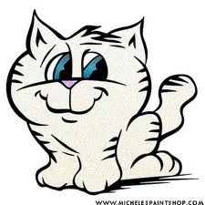
A cat and a dog are on the sand

Slide 115
eye

Slide 116
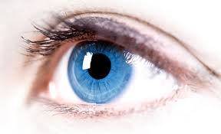
eye

Slide 117
ear

Slide 118
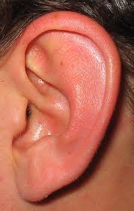
ear

Slide 119
mouth

Slide 120
mouth

Slide 121
nose

Slide 122
nose

Slide 123
leg

Slide 124
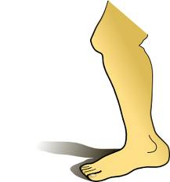
leg

Slide 125
wing

Slide 126
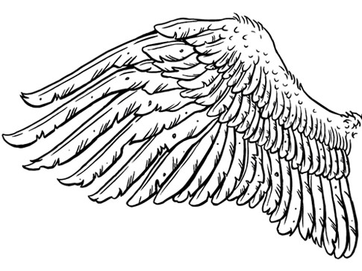
wing

Slide 127
neck

Slide 128
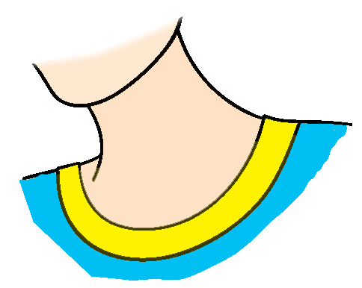
neck

Slide 129
frog

Slide 130
frog

Slide 131
fish

Slide 132
fish

Slide 133
penguin

Slide 134
penguin

Slide 135
dolphin

Slide 136
dolphin

Slide 137
bird

Slide 138
bird

Slide 139
rabbit

Slide 140
rabbit

Slide 141
water

Slide 142
water

Slide 143
The dolphin is gray

Slide 144
The dolphin is gray

